Slide 1
Lecture 17
Topics:
Mathematical Induction

Slide 2
5.1 Mathematical Induction
5.1.1 Introduction
Suppose that we have an infinite ladder, as shown in Figure 1, and we want to know whether we can reach every step on this ladder. We know two things:
1. We can reach the first rung of the ladder.
2. If we can reach a particular rung of the ladder, then we can reach the next rung.

Slide 3
5.1 Mathematical Induction (Continued)
For example, after 100 uses of (2), we know that we can reach the 101st rung. But can we conclude that we are able to reach every rung of this infinite ladder? The answer is yes, something we can verify using an important proof technique called mathematical induction. That is, we can show that the statement that we can each the nth rung of the ladder is true for all positive integers n.
Mathematical induction is an extremely important proof technique that can be used to prove assertions of this type.

Slide 4
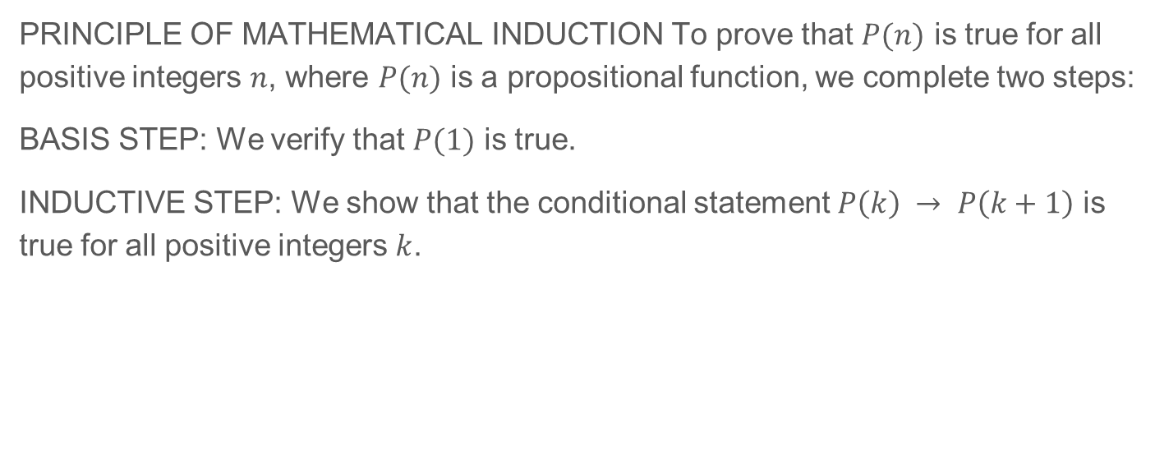
5.1 Mathematical Induction (Continued)

Slide 5
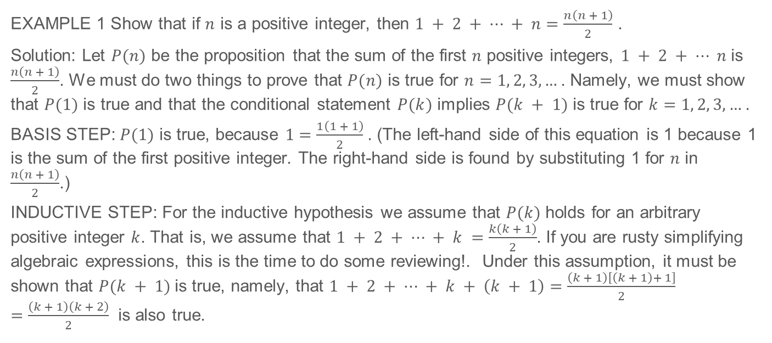
5.1 Mathematical Induction (Continued)

Slide 6
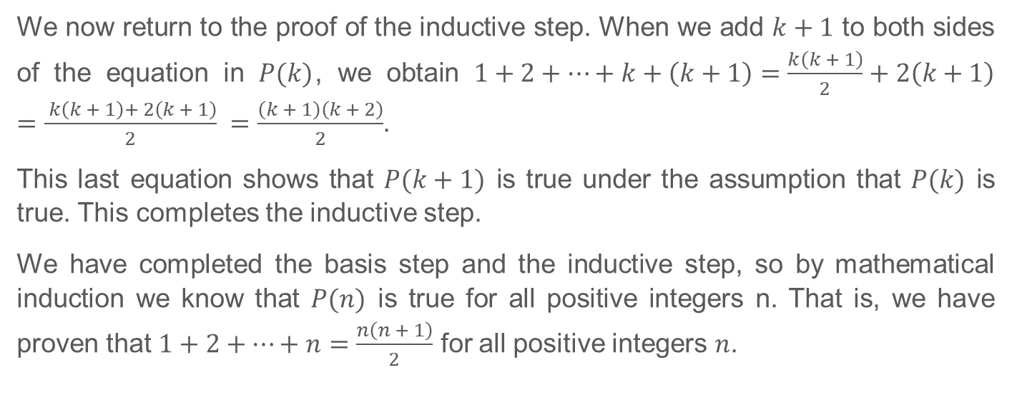
5.1 Mathematical Induction (Continued)

Slide 7
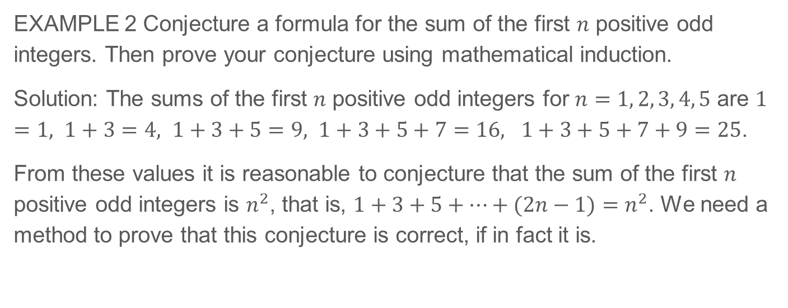
5.1 Mathematical Induction (Continued)

Slide 8
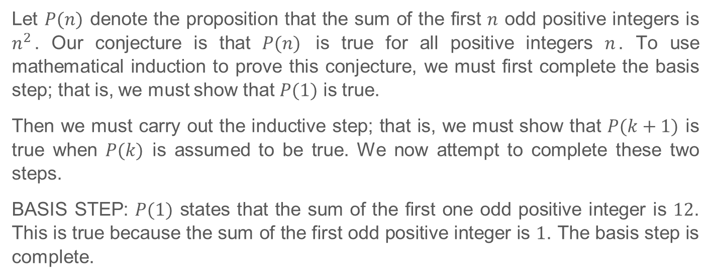
5.1 Mathematical Induction (Continued)

Slide 9
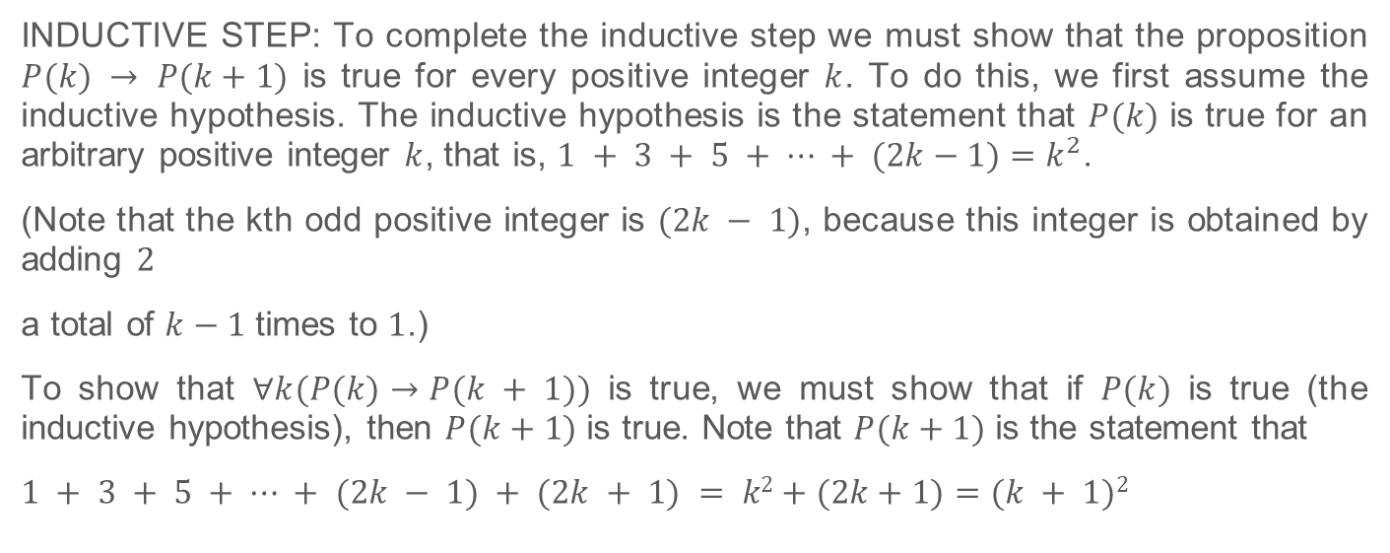
5.1 Mathematical Induction (Continued)

Slide 10
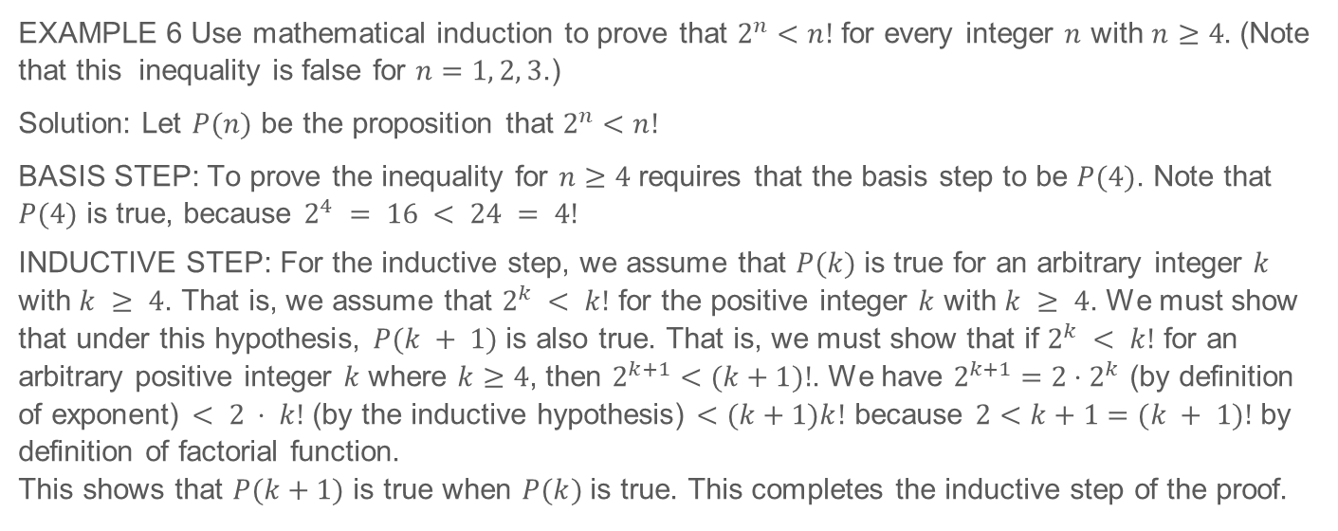
5.1 Mathematical Induction (Continued)

Slide 11
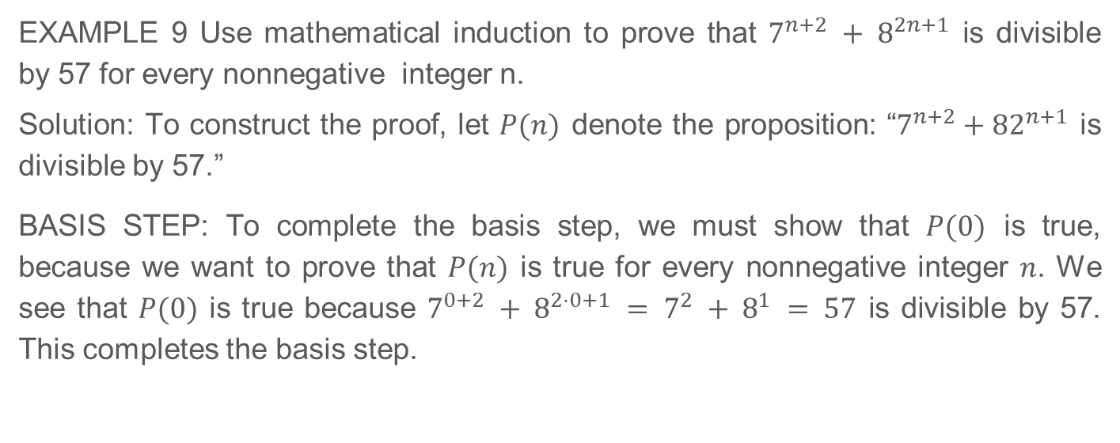
5.1 Mathematical Induction (Continued)

Slide 12
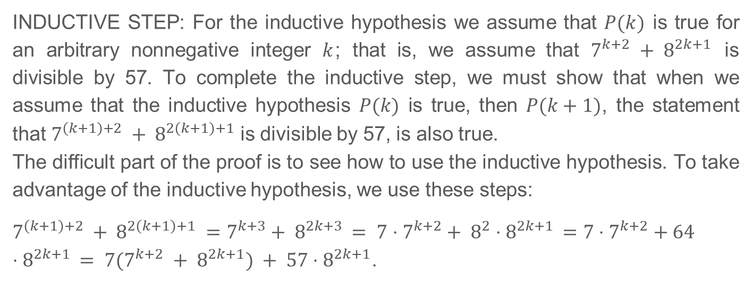
5.1 Mathematical Induction (Continued)

Slide 13
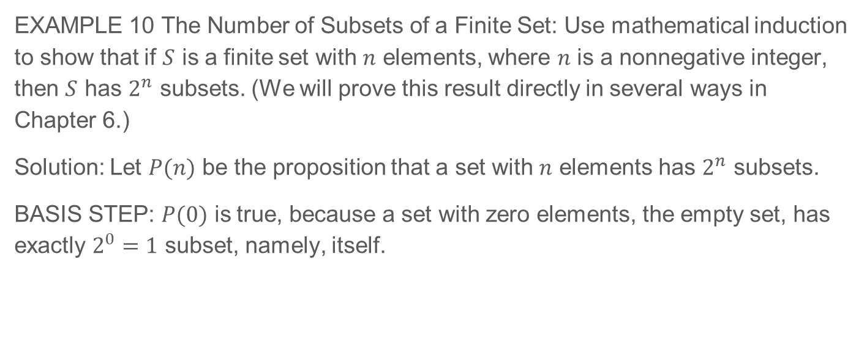
5.1 Mathematical Induction (Continued)

Slide 14
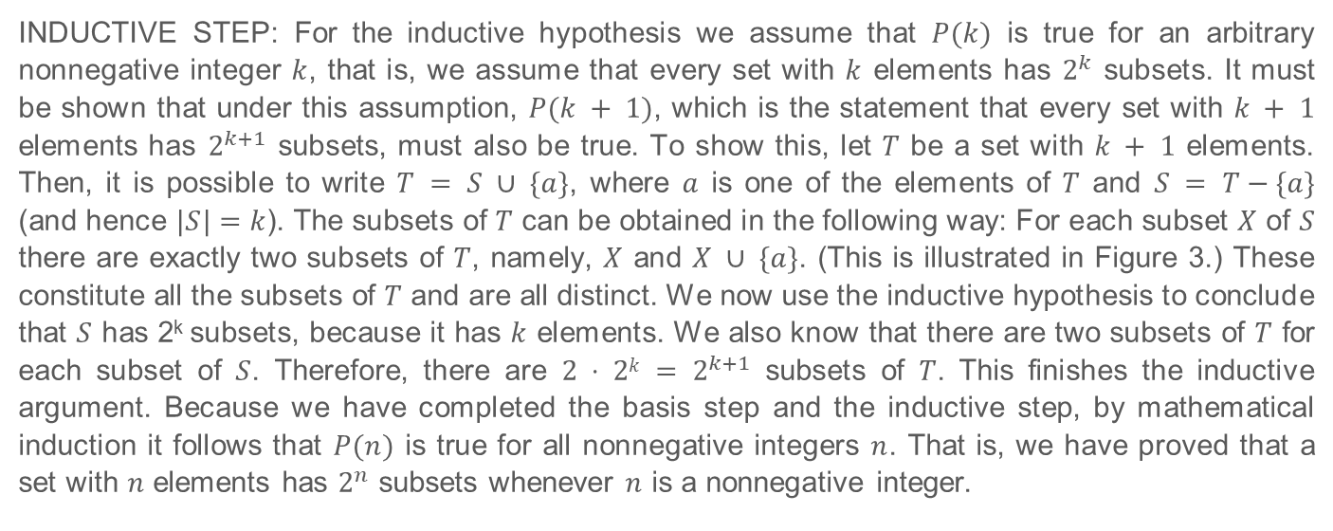
5.1 Mathematical Induction (Continued)

Slide 15
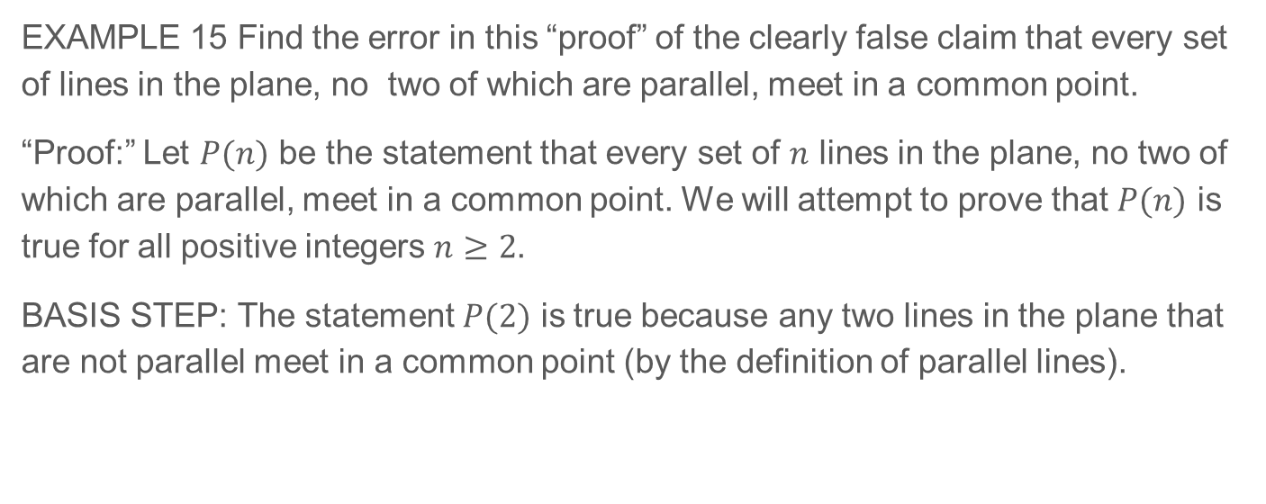
5.1.8 Mistaken Proofs By Mathematical Induction

Slide 16
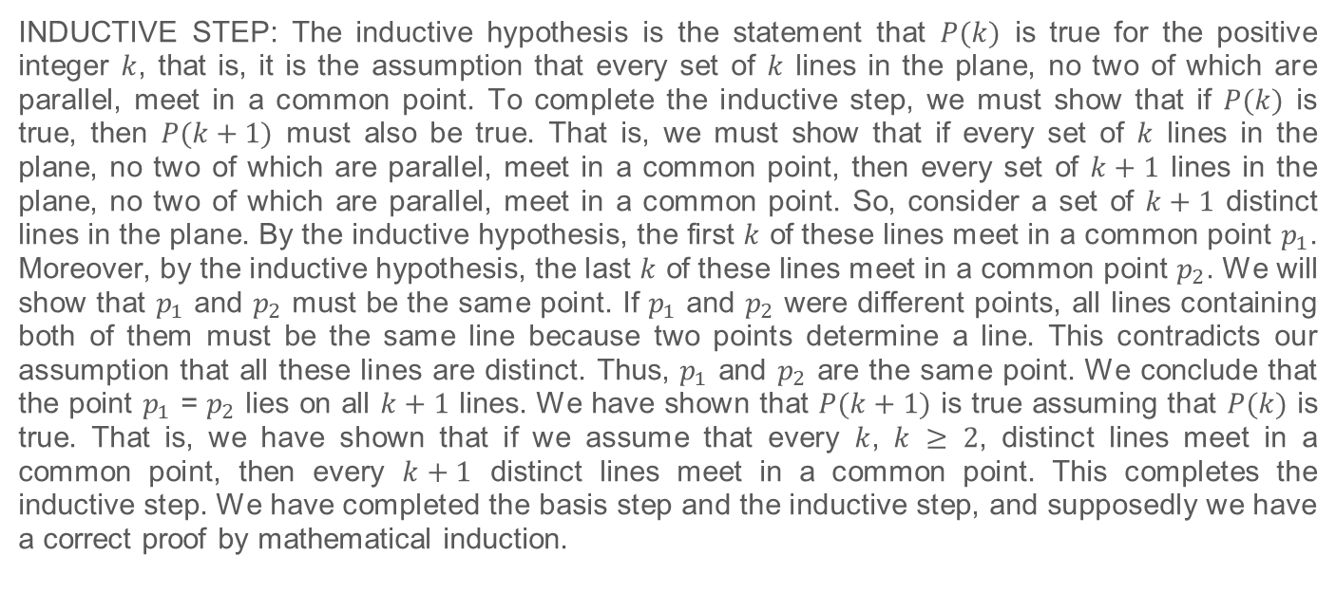
5.1.8 Mistaken Proofs By Mathematical Induction (Continued)

